Slide 1
Chapter 3 Selections
Liang, Introduction to Java Programming, Tenth Edition, (c) 2015 Pearson Education, Inc. All rights reserved.

Slide 2
Logical Operators
Operator | Name | Description
! | not | logical negation
&& | and | logical conjunction
|| | or | logical disjunction
^ | exclusive or | logical exclusion

Slide 3
Truth Table for Operator !
p | !p | Example (assume age = 24, weight = 140)
true | false | !(age > 18) is false, because (age > 18) is true.
false | true | !(weight == 150) is true, because (weight == 150) is false.

Slide 4
Truth Table for Operator &&
p₁ | p₂ | p₁ && p₂ | Example (assume age = 24, weight = 140)
false | false | false | (age <= 18) && (weight < 140) is false, because both conditions are both false.
false | true | false
true | false | false | (age > 18) && (weight > 140) is false, because (weight > 140) is false.
true | true | true | (age > 18) && (weight >= 140) is true, because both (age > 18) and (weight >= 140) are true.

Slide 5
Truth Table for Operator ||
p₁ | p₂ | p₁ || p₂ | Example (assume age = 24, weight = 140)
false | false | false
false | true | true | (age > 34) || (weight <= 140) is true, because (age > 34) is false, but (weight <= 140) is true.
true | false | true | (age > 14) || (weight >= 150) is false, because (age > 14) is true.
true | true | true

Slide 6
Problem: Determining Leap Year?
This program first prompts the user to enter a year as an int value and checks if it is a leap year.
A year is a leap year if it is divisible by 4 but not by 100, or it is divisible by 400.
(year % 4 == 0 && year % 100 != 0) || (year % 400 == 0)
LeapYear
Run

Slide 7
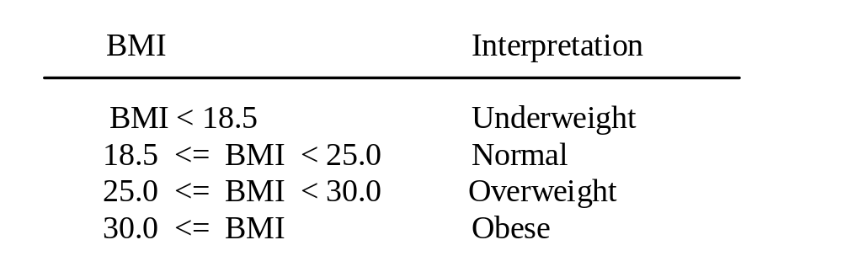
Problem: Body Mass Index
Body Mass Index (BMI) is a measure of health on weight. It can be calculated by taking your weight in kilograms and dividing by the square of your height in meters. The interpretation of BMI for people 16 years or older is as follows:
ComputeAndInterpretBMI
Run

Slide 8
Listing 3.4
Pages 91-2
ComputeAndInterpretBMI.java

